Slide 1
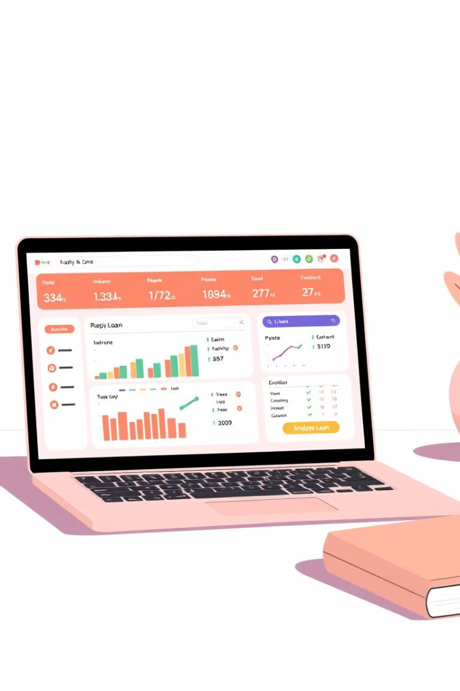
Mini Project:
Bank Loan Analysis
Department of Technology Shivaji University, Kolhapur
Guide – H. P. Khandagale
Presented By –
1.Ankita Nadarge
2.Pranali Oulkar
3.Vaidehi Mangrule

Slide 2
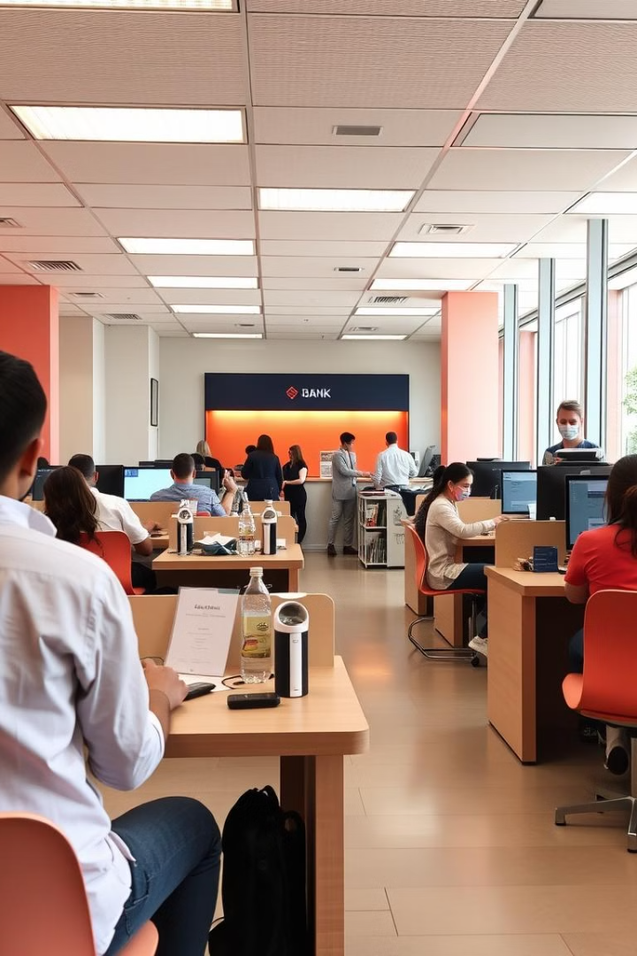
Bank Loan Analysis
This project features an interactive bank loan analysis dashboard built with Python, Dash, and visualization tools like Plotly. It helps financial institutions manage loan applications by offering insights into defaults, interest rates, and repayment trends. With user-friendly filters and real-time metrics, it aids in identifying high-risk profiles and improving decision-making to reduce financial risks.

Slide 3
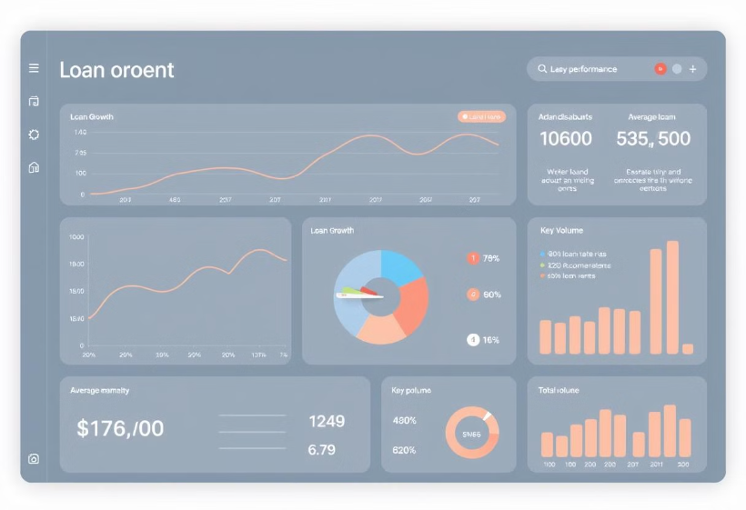

Introduction
This project introduces an interactive dashboard to help banks make faster, data-driven loan decisions. Traditional manual methods are slow and error-prone. By using Python, machine learning, and visualization tools, the dashboard predicts loan outcomes, identifies risks, and reveals borrower insights.
Built with Pandas, Scikit-learn, Plotly, and Dash, it improves accuracy, transparency, and efficiency in the loan approval process.

Slide 4
Objectives of the Dashboard
Develop an interactive dashboard for analyzing and predicting bank loan approvals.
Provide real-time insights into customer and loan data.
Identify default patterns to reduce financial risks.
Assist loan officers with a clean, user-friendly visualization tool.

Slide 5
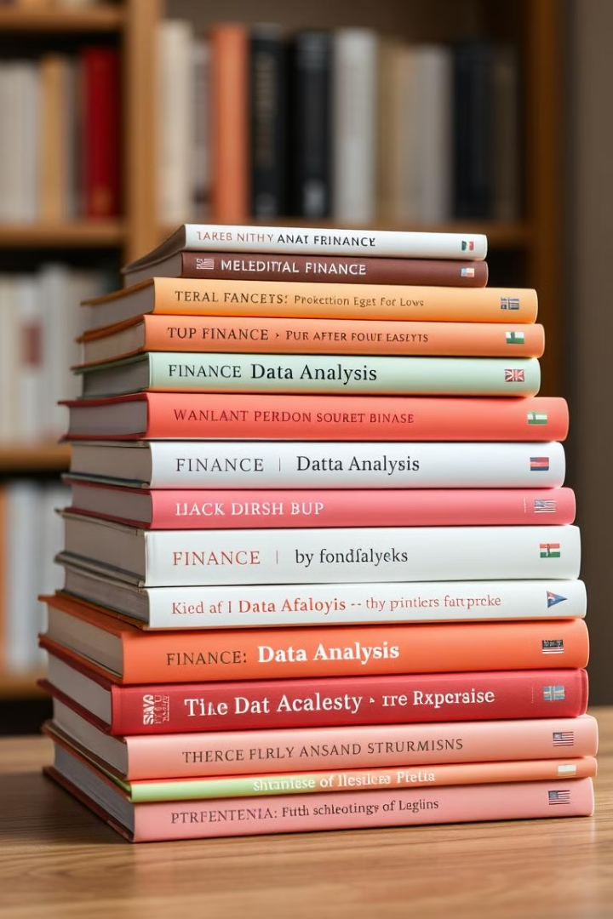
Key Literature on Loan Prediction
Predictive Modelling
Machine Learning
"Predictive Modelling in Banking" – IEEE (2020)
"Machine Learning for Loan Default Prediction" – Elsevier (2019)
Big Data Analytics
"Big Data Analytics in Financial Services" – Springer (2021)
These publications provide a foundation for understanding the methodologies and techniques used in the development of the loan analysis dashboard. They cover predictive modeling, machine learning applications, and the use of big data analytics in the financial sector.

Slide 6



Software Components
Microsoft SQL Server
Storing, managing, and querying structured financial data efficiently.
Power BI
Creating interactive visual reports and dashboards.
Plotly, Pandas, NumPy, Matplotlib, Scikit-learn
Data manipulation, visualization, and machine learning.

Slide 7
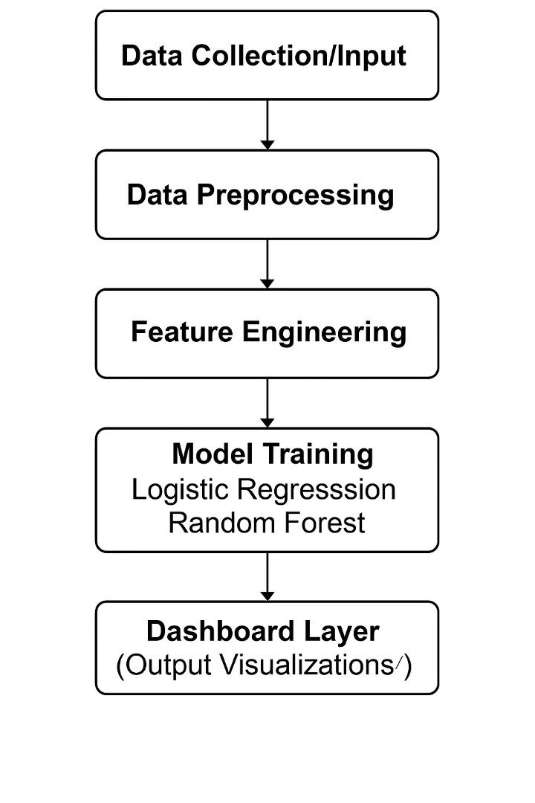




System Analysis and Methodology
Data Collection
Gathering relevant loan and customer data.
Data Preprocessing
Cleaning and preparing data for analysis.
Feature Engineering
Creating new features to improve model accuracy.
Model Training and Evaluation
Training and evaluating predictive models.

Slide 8
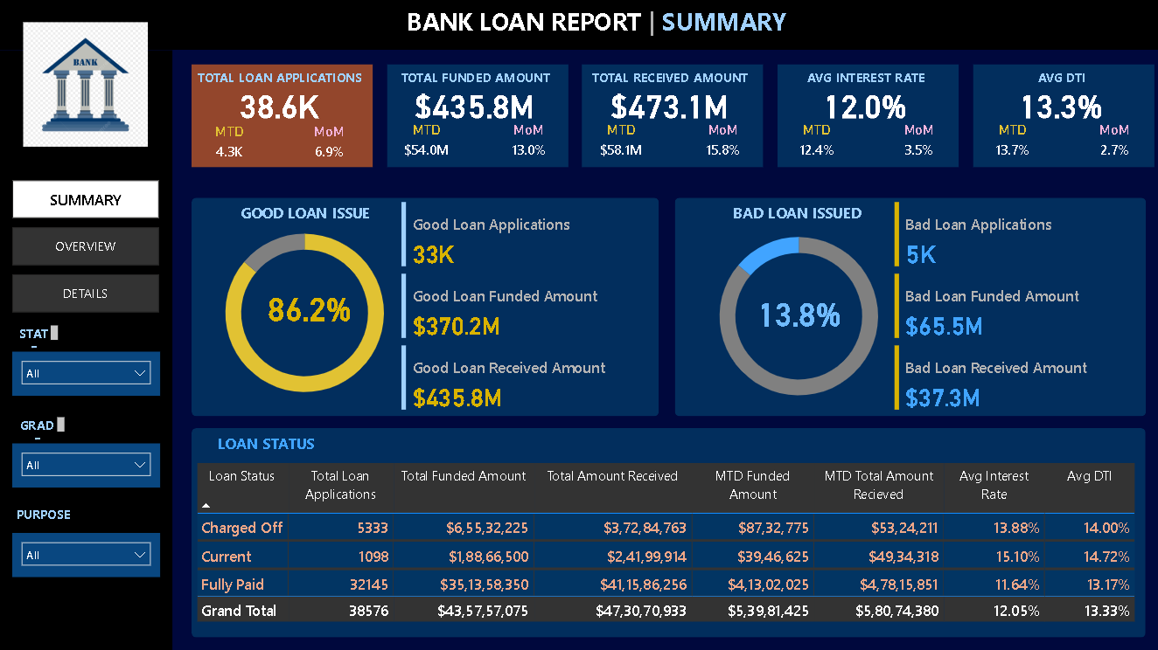
Results and Key Insights
Dashboard 1: Bank Loan Report -Summary
📊 Total Applications: 38.6K
💰 Amount Funded: $435.8M
💵 Amount Received: $473.1M
📈 Avg Interest Rate: 12.0%
📉 Avg DTI: 13.3%
✅ Good Loans: 86.2% (33K apps, $370.2M)
❌ Bad) Loans: 13.8% (5K apps, $65.5M
Loan Status Categories:
Charged Off
Current
Fully Paid

Slide 9
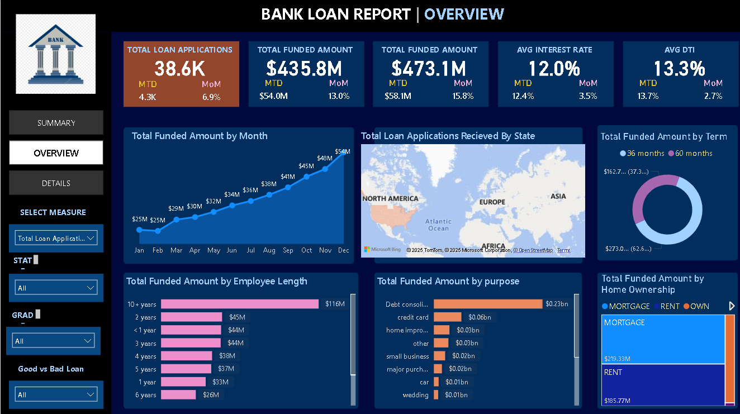
Dashboard 2: Bank Loan Report -Overview
Key Insights:
📊 Monthly Funding: Steady growth
📆 Loan Term: 60 months most common
👔 Top Funding: Applicants with 10+ years experience
🎯 Top Purpose: Debt consolidation
🏠 Highest Loan Amounts: Received by renters
🗺️ Geography: Applications from multiple states

Slide 10
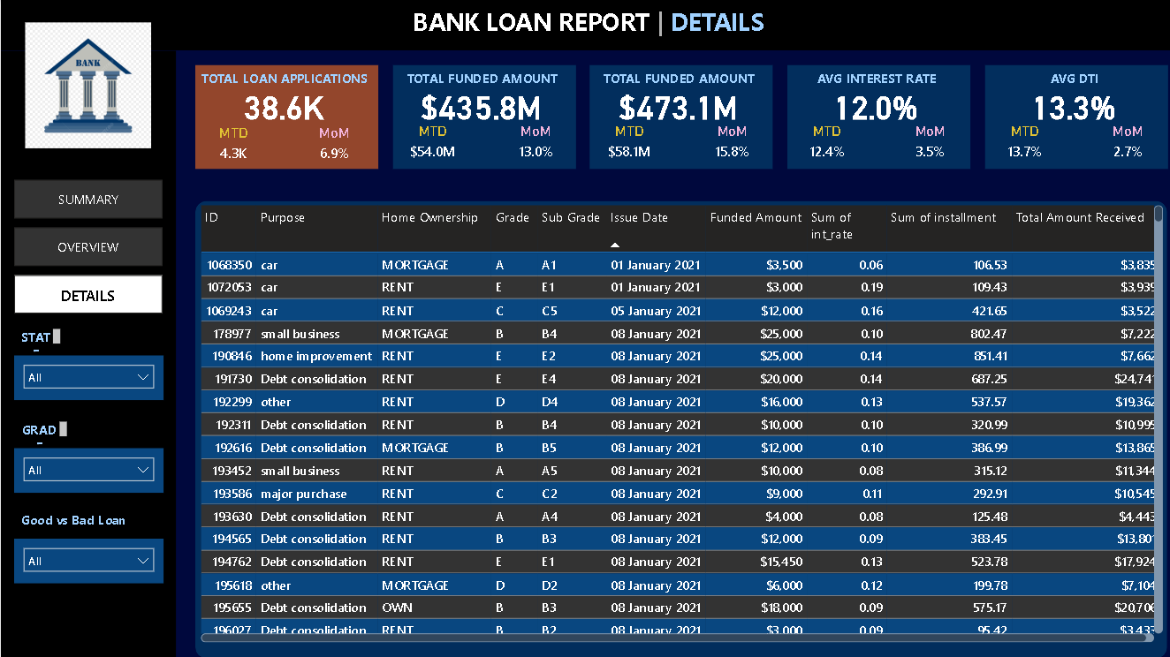
Dashboard 3 :Bank Loan Report -Details
📌 Loan Purposes: Car, small business, debt consolidation, etc.
🏠 Home Ownership: MORTGAGE, RENT, OWN
🏷️ Grades: A to E
📅 Issue Date: Mainly Jan - Dec 2021
💵 Funded Amounts: $3K – $25K
📈 Interest Rates: 6% – 20%
💳 Monthly Installments:
High loans ($25K): > $800/month
Low loans ($3K–$4K): < $130/month
📊 Purpose: Assess borrower profiles & repayment trends efficiently

Slide 11
Conclusion and Future Enhancements
Interactive Dashboard
1
Built using Dash & Plotly.
Key Approval Factors
2
Analyzed historical data.
Data-Driven Decisions
3
Aids in default risk reduction.
The interactive loan analysis dashboard successfully provides data-driven insights for bank professionals, aiding in default risk reduction. Future enhancements include integrating real-time data via APIs, deploying on cloud platforms, using advanced models like XGBoost and Deep Learning, and adding customer profiling for personalized recommendations.

Slide 12


